Slide 1

Face Detection using deep learning
By – Ishmit Singh
Sec – B-Tech CSE-A
University Roll No. – 2108847
Mentored by – Mr. Ankit Gupta

Slide 2
Problem Statement
Detection and counting of faces present in digital media in Real Time
Making a cohesive UI and Report of the Findings
Used TensorFlow and Open CV to tackle this Problem
Used fpdf and CustomTkinter for tackling this problem

Slide 3
Introduction
A real-life application of human face object detection and counting model.
Used Image Processing, Video Processing, Object Detection and Deep neural networks which are rigorous parts of modern Artificial Intelligence.
The project will focus on face object detection and count of faces in an image or in a real time video through camera or some other source.
Researched on three different methods and algorithms to detect a human face object in order of their increasing accuracy.

Slide 4
Workable Solutions
This method uses a xml file consisting of functions and definitions of Image and Video processing.
To make answer more accurate imultis and argparse were also used
Counts occurrences of gradient orientation in localized portion of an image
Uses both magnitude and angle to calculate gradient
TensorFlow
Creates a convolutional feature map which warps all identified locations into squares
Pros – fast
Pros – fast , simple
Histogram of Oriented Gradients (HOG)
HAAR Cascade
Cons - Low accuracy on media with tilted and partial visible people
Cons – Low accuracy almost same as haar cascade methode
Pros – Very accurate
Cons – complex and slow
ROL resizes these squares and SoftMax layer predicts the region proposal class and offset box values
I decided on using TensorFlow with MobileNet SSD to solve the problem statement

Slide 5
Basic methodology
CustomTkinter and Tkinter used to take input from user and present output using an UI
Open CV , PIL used to take given input , use the TensorFlow API on it for counting and provide the UI an output to display
Matplotlib.pyplot and fpdf used to make enumeration plots, accuracy plots and a general pdf report

Slide 6
Working of TensorFlow Api
A frozen interference trained model is loaded
Input is loaded and parsed to be compared against the model which gives out detected areas in image, its confidence in the detection and the number of people being detected per frame
This output is then returned to the main program for each frame of digital media provided to the API

Slide 7
working of project
UI made in customtkinter and tkinter takes user input and gives user a preview of their input
OpenCV parses this input into readable form for and calls the TensorFlow API to give it the locations of people detected
OpenCV and PIL superimpose the boxes on the given media and form a cohesive output to be given to the user
Matplotlib uses the data to create 2 plots of people counter per frame and level of confidence of api on the result per frame
Fpdf makes a cohesive general report of the data
UI takes all the outputs and provides it to the end user

Slide 8
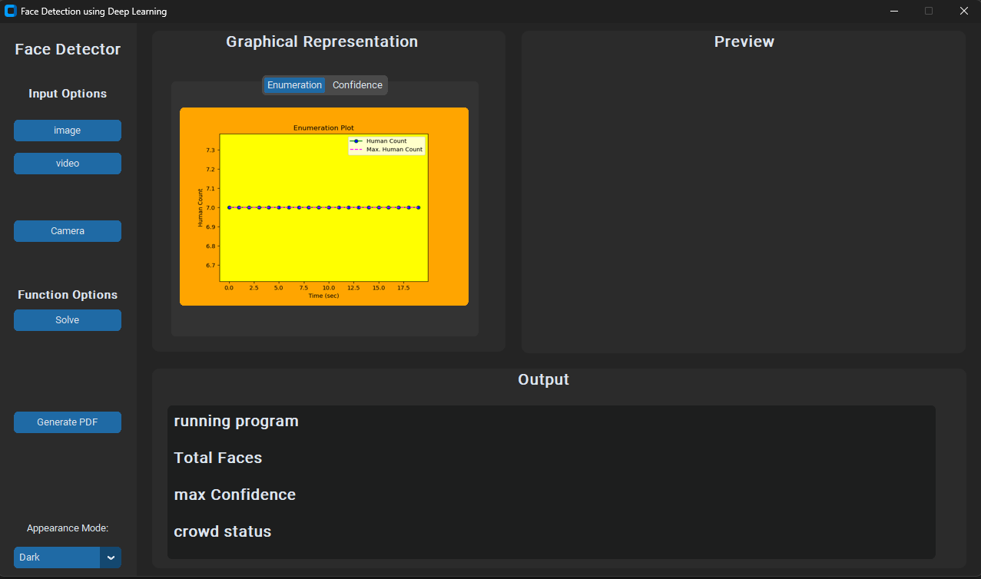
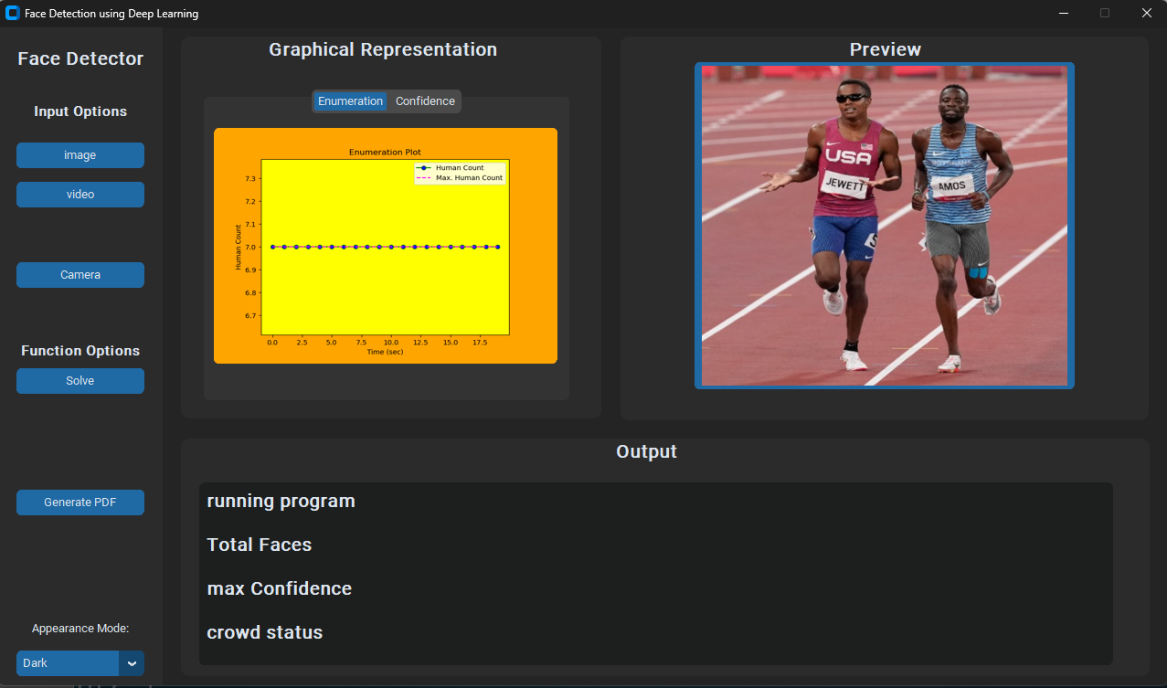
Result and discussion
A Sample image of UI given to user is -
Ui after user enters a sample input -

Slide 9
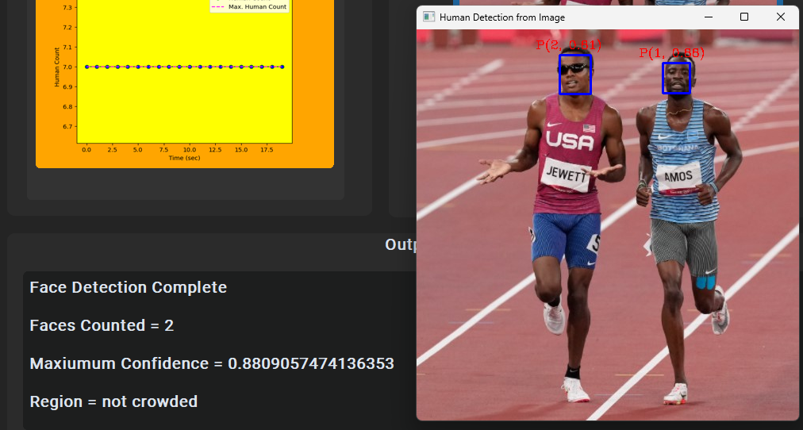
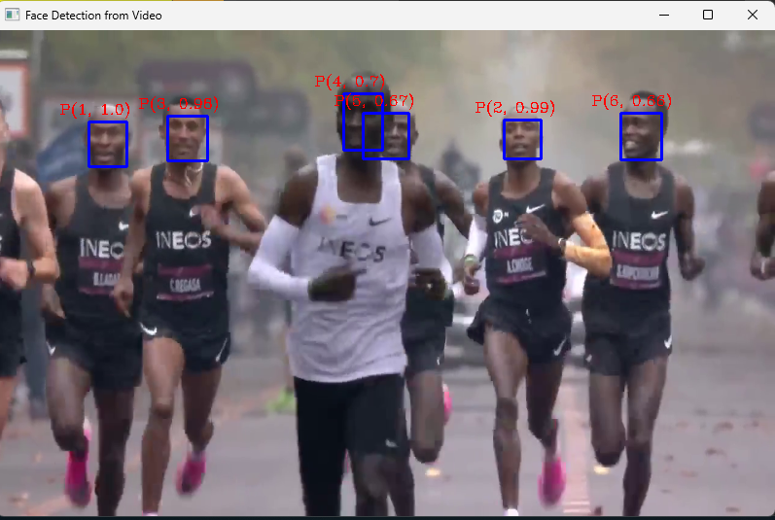
Outputs provided by project
For images -
For camera/videos -

Slide 10
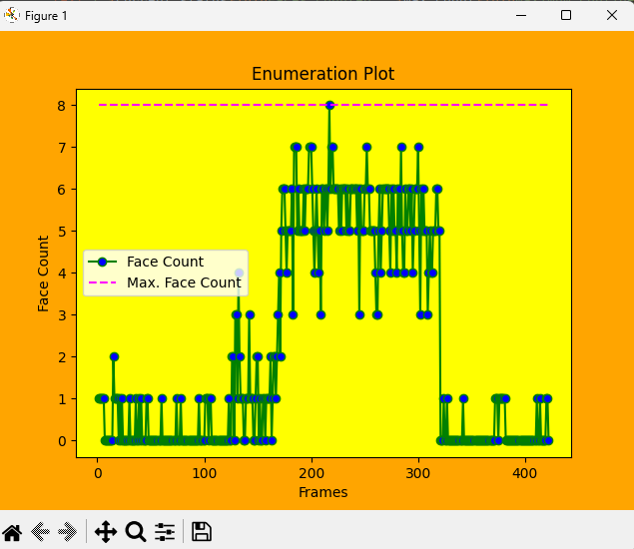
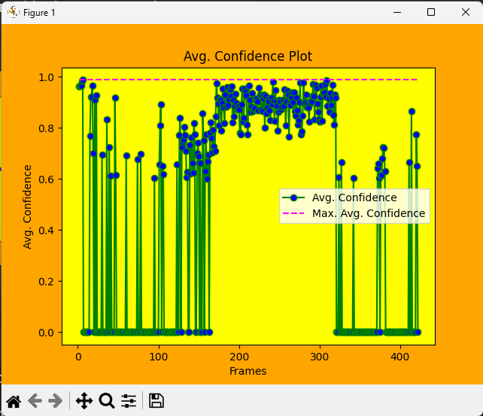
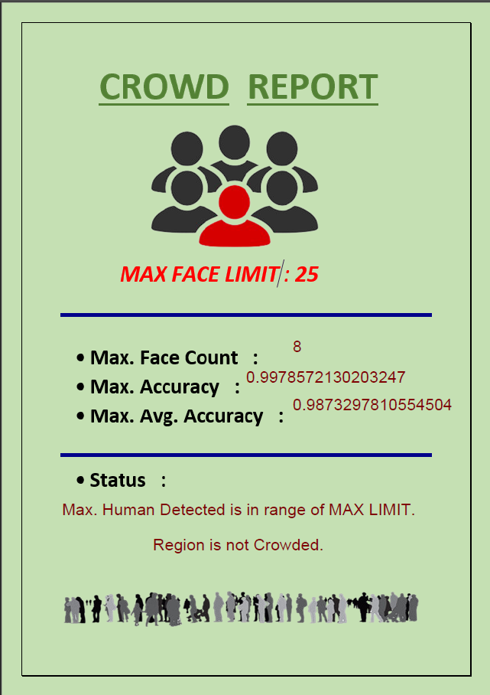
PLOTS AND PDF PROVIDED BY PROJECT FOR A SAMPLE VIDEO

Slide 11
Conclusion and future work
This project can be implemented in the commercial and rushed areas for having an accurate human data and for controlling the crowd and can be a good help for data collection
In the future , I would work to make this process much faster than now and have multi-threading in it so that multiple instances of it can be run at the same time while also making the UI more fluid than it is now

